Slide 1
# ConflictPy: a scan of armed civil conflict from a global, regional and country-specific vantagepoint over the last 30 years
#ConflictPy concatenate = ‘Mahdi Amirisefat’ + ‘Max Patterson’ + ‘Anastasios Tomazos’ + ‘Erin Wills’

Slide 2
#Uppsala Conflict Data Program
# What is the UCDP?
# Data: UCDP Georeferenced Event Dataset (GED) Global version 19.1*
# Illustrates conflict behavior geographically
# Armed Civil Conflict: 1989-2018 excluding Syria
# Global Standard: “Armed Conflict” definition
_____
*Sundberg, Ralph, and Erik Melander, 2013, “Introducing the UCDP Georeferenced Event Dataset”, Journal of Peace Research, vol.50, no.4, 523-532
Högbladh Stina, 2019, “UCDP GED Codebook version 19.1”, Department of Peace and Conflict Research, Uppsala Universit

Slide 3

ConflictPy: research topic and key questions
# research topic:
The fall of the Berlin Wall and subsequent collapse of the Soviet Union brought about significant shifts in the type and severity of civil wars over the last 30 years as the sun set on the cold war and the dawn of new geo-political order emerged
We believe that this geo-political order gave rise to different types of conflicts amongst disparate combatants vying for power within a country
# key questions:
Has the type and/or severity of intrastate conflict changed over this period (1989-2018)?
How have these conflicts changed over this period across the 5 regions? Have we seen any trends?
Have we seen any trends recently in any particular region which warrant further exploration?

Slide 4
# {What’s in the Dataset?}
Print(“Data Extraction Done”)
“deaths_civilians”
”side_a”
“side_b”
“country”
“longitude”
“latitude”
“best”
“region”
“deaths_b”
“deaths_a”
“date_start”

Slide 5
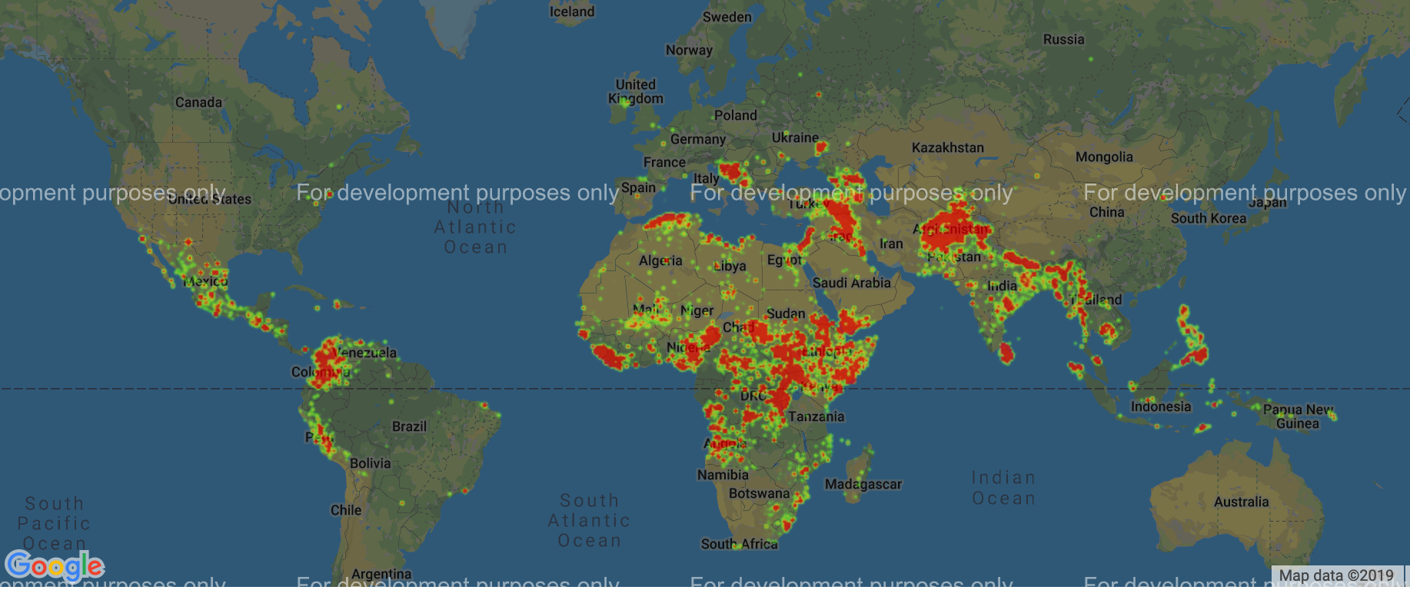
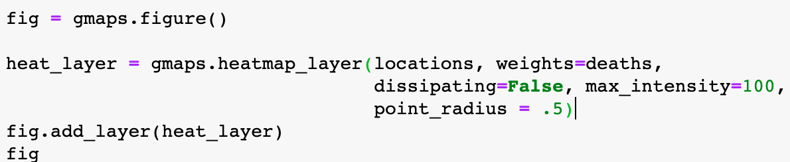
# Global Vantagepoint: total fatalities heatmap (1989-2018)

Slide 6
# Regional Vantagepoint: Asia trending upward since 2013, and, along with the Middle East, most constant trends over 30 years

Slide 7
# Excluded three months in 1994…

Slide 8
# Country-Specific Vantagepoint: Afghanistan trending upward

Slide 9
# Honing in on Afghanistan…: relatively even distribution of data with many data points and no outliers

Slide 10
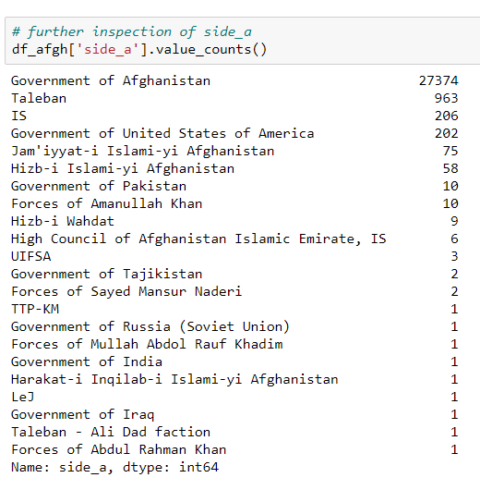
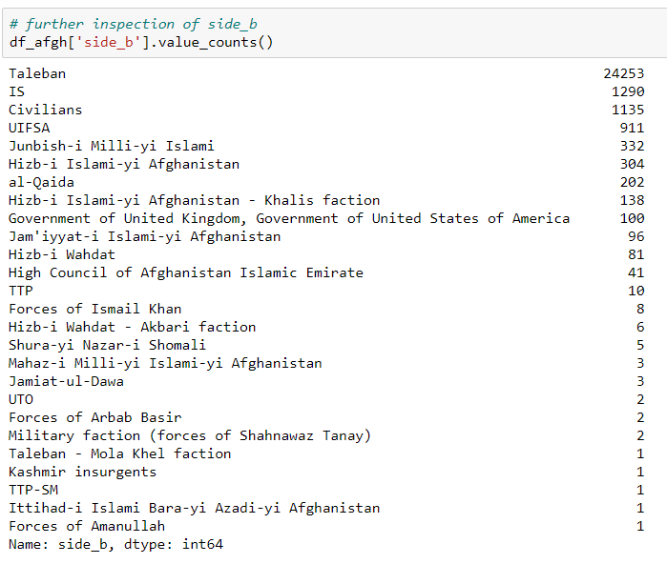
# Afghanistan: inspecting the conflict groups

Slide 11
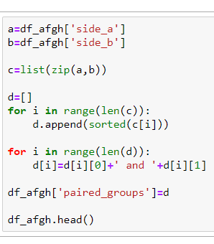
# Afghanistan: reducing two variables into one variable
#Step 1:
#Step 2:
#Step 3:
#Step 4:
#Step 5:
Create a paired list
Create a list of alphabetical paired items
Using the indexing properties, write each pair as a single text string
Add the information as a column in the dataframe
Inspect the result for consistency/validity

Slide 12
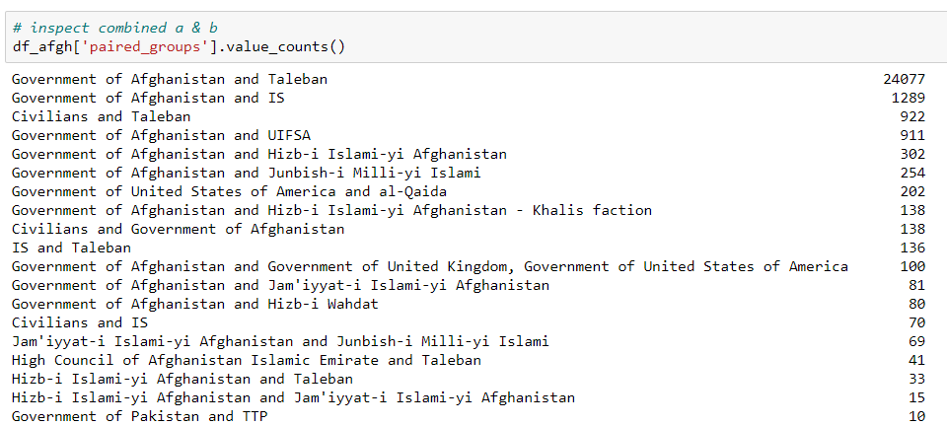
# Afghanistan: the effect

Slide 13
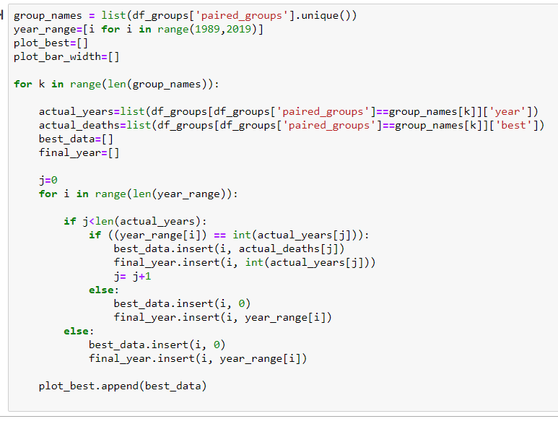
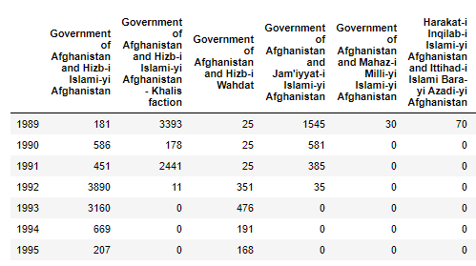
# Afghanistan: filling in zeros into [‘paired_groups’][‘best’]
df_bar_plot = pd.DataFrame.from_records(
plot_best,
columns=year_range,
index=group_names
)

Slide 14
# Afghanistan: a deep dive into combatants
Government of Afghanistan and Hizb-I Islami-yi Afghanistan – Khalis faction
Government of Afghanistan and Taleban
Government of Afghanistan and Jam’iyat-i Islami-yi Afghanistan
Government of Afghanistan and IS
Government of Afghanistan and Junbish-I Milli-yi Islami
Government of United States of America and al-Qaida
Government of Afghanistan and UIFSA
Civilians and Government of Afghanistan
Government of Afghanistan and Hizb-I Islami-yi Afghanistan

Slide 15
# Afghanistan: fatalities
heat map

Slide 16
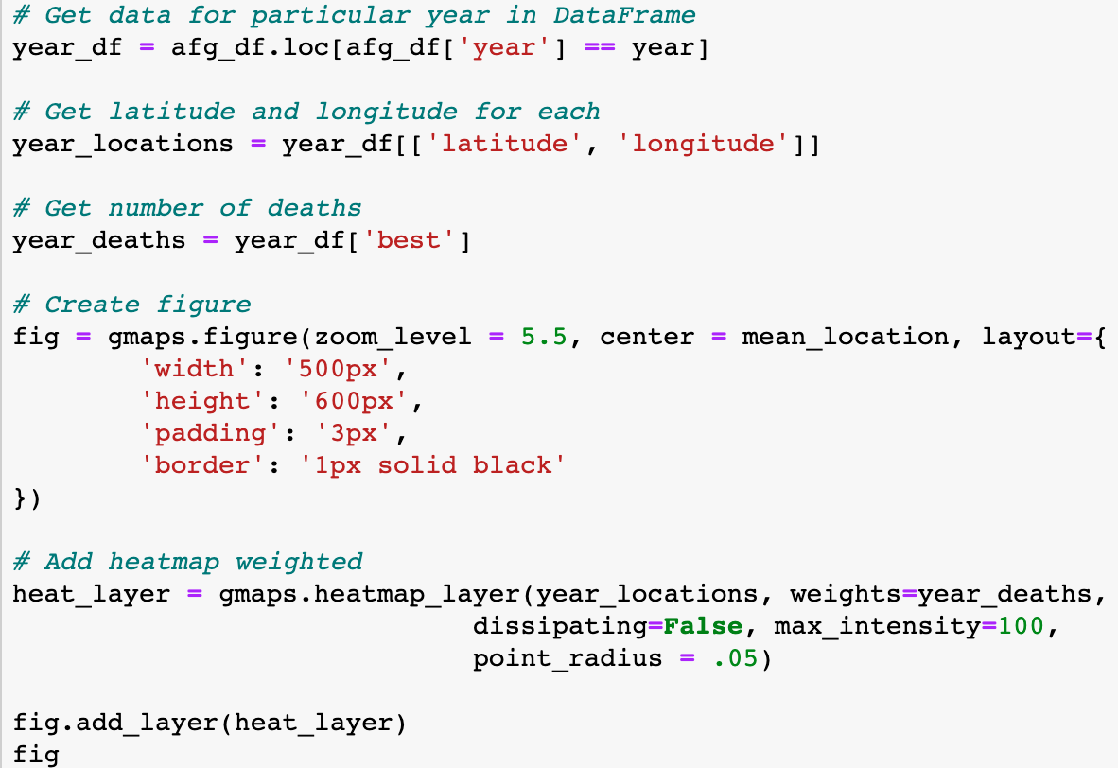
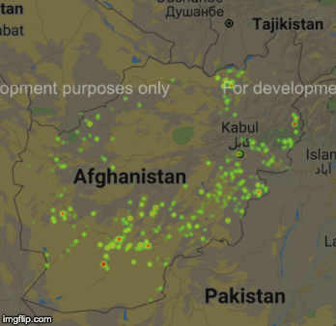
# Afghanistan: fatalities over 30 years

Slide 17
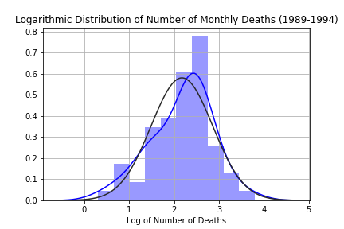
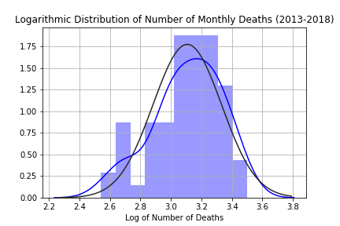
# Comparing Fatalities in Afghanistan: not insignificant…
Group 1 = Number of deaths per month from 1989 - 1994
Group 2 = Number of deaths per month from 2013 - 2018
𝐻₀: μ₁= μ₂
p ≅ 1.9 e-16

Slide 18
# input(class_questions?)
# print(Thank you!): ‘Mahdi Amirisefat’, ‘Max Patterson’, ‘Anastasios Tomazos’ & ‘Erin Wills’

Slide 19
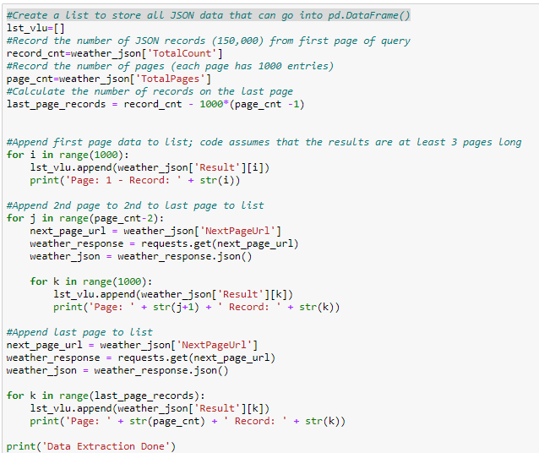
API Call
df2.to_csv('conflict_data.csv')

Slide 20
